Slide 1
“Easy Test” Model – Internet-based Self-testing a cross-sectional survey targeting MSM who never tested before in 14 provinces of China Presenters: Xia Jin, Yugang Bao
Abstract number: WEPDC0105
Over 80%
Over 70%
Less than
30%
Internet-based MSM
(*using online social networks/APPs)
BMC Infect Dis, 2014,14: 696
Internet-based MSM meet sexual partners online
Clin Infect Dis, 2013, 57(2): 298-309
HIV test proportion of internet-based MSM in last one year
Chin J AIDS STD, 2016, 22(6): 441-3

Slide 2
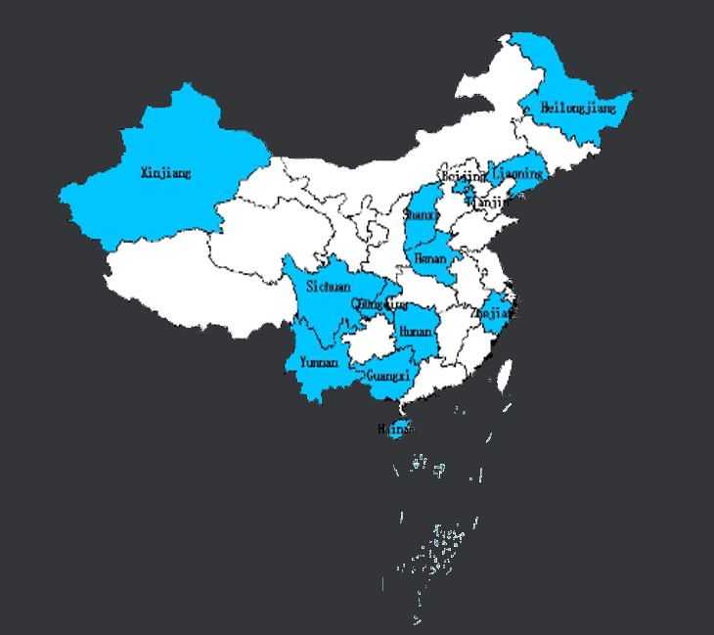
1,015 participants applied self-test kits
11 females delete
8 HIV positive
117 not engaged in anal sex delete
Signed informed consent electronically
Questionnaire
Pay a deposit
879 eligible MSM
683 self-test and feedback test results (77.7%)
Deposit back
*Lifetime HIV testing frequency - HIV positive:
Total: 14.3% (98/683)
Never: 18.8% (55/293)
1-2: 16.2% (33/204)
3-4: 7.0% (8/114)
5-: 2.8% (2/72)
Oct - Dec, 2017
Cover 14 of 31 provinces in China
Local CBOs (peer educators)
Peer-referral & disseminating self-testing information through internet
IRB
98 HIV positive (14.3%)
71 linked and enrolled in care (72.4%)
One-to-one accompanied referral
Flow chart of “Easy Test”

Slide 3
Sexual Behaviors of Internet Based Self-test MSM
Sexual behaviors | Homosexual behaviors (N=879) |  |  | Heterosexual behaviors (N=88)
 | Never tested HIV before (N=352) | Ever tested HIV (N=527) |  | Never tested HIV before (N=27) | Ever tested HIV (N=61)
Seldom or never using condoms during sexual intercourse in the last 3 months | 37% | 24% |  | 88% | 59%
 | (108/295) | (113/471) |  | (21/24) | (27/46)
Reported condom use during most recent sexual intercourse | 76% | 85% |  | 26% | 56%
 | (266/352) | (450/527) |  | (5/19) | (22/39)
--Failed to consistently use condoms | 48% | 35% |  | 100% | 100%
 | (128/266) | (156/450) |  | (5/5) | (22/22)
Innovative, effective way access MSM who are reluctant to test offline
Effectively access HIV treatment for HIV-positive MSM

